Slide 1

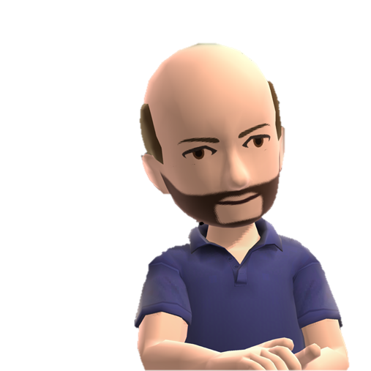
Azure Automation
Presented by Mike Wood
http://mvwood.com
@mikewo on Twitter
mwood@sentryone.com

Slide 2




}
CHEF
}
automation vs Automation
PUPPET
}
POWERSHELL DSC
}
AZURE RESOURCE MANAGER
Images: Azure Symbols by Microsoft, Chef and Puppet Logos property of Chef and Puppet Labs
Notes:
Images: Azure Symbols by Microsoft, Chef and Puppet Logos property of Chef and Puppet Labs

Slide 3

Why Automation?
“Thinking RFID” by Jacob Bøtter / CC By

Slide 4
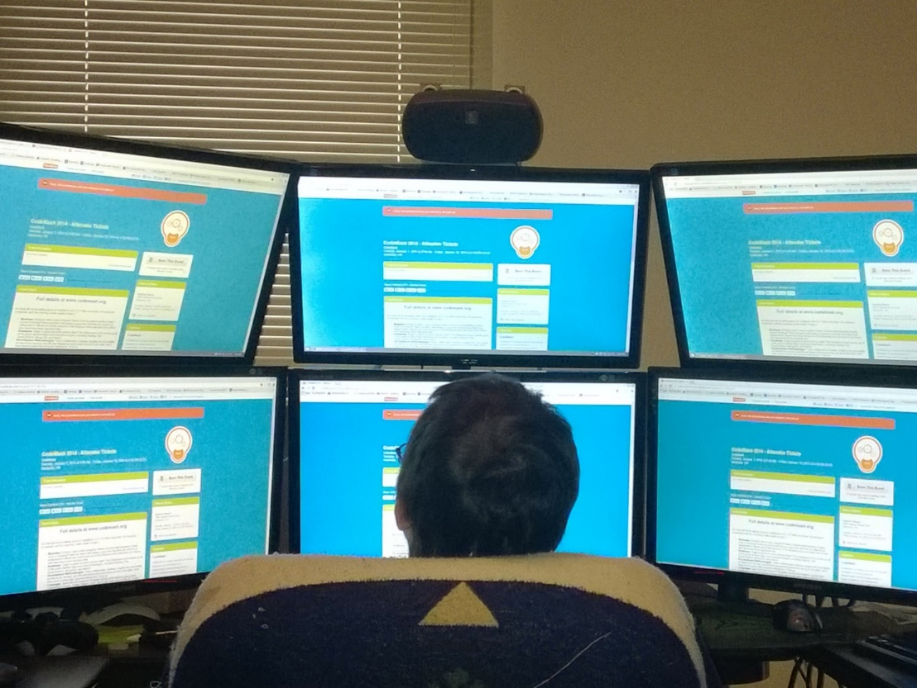
Humans
Do Not Scale Well
Photo by Ondrej Balas / Used with permission
Notes:
Photo by mantasmagorical - MorgueFile - http://mrg.bz/4cuBQE

Slide 5

Consistency Matters
“It’s really hard to share a bunch of mouse clicks as repeatable process. “
- Jeffrey Snover, Arrested DevOps Podcast, Feb 12th, 2015
Untitled by GaborfromHungary / MorgueFile
Notes:
Image: Untitled by GaborfromHungary / MorgueFile - http://mrg.bz/xPpSUy

Slide 6
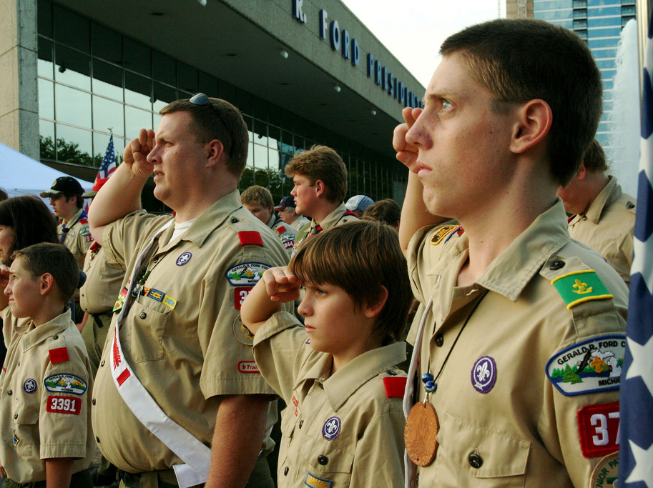
Be Prepared
“Boy Scout Flag Salute at Gerald R. Ford Museum” by Steven Depolo / CC By
Notes:
Image: “Boy Scout Flag Salute at Gerald R. Ford Museum” by Steven Depolo / CC By - http://www.flickr.com/photos/stevendepolo/3245814719/sizes/l/, used under creative commons attribution license.

Slide 7

Tony Carter
“ The GUI makes you weak. “
Photo by dmscs / morgueFile
Notes:
Image: Photo by dmscs / morgueFile - http://mrg.bz/2xfykU

Slide 8
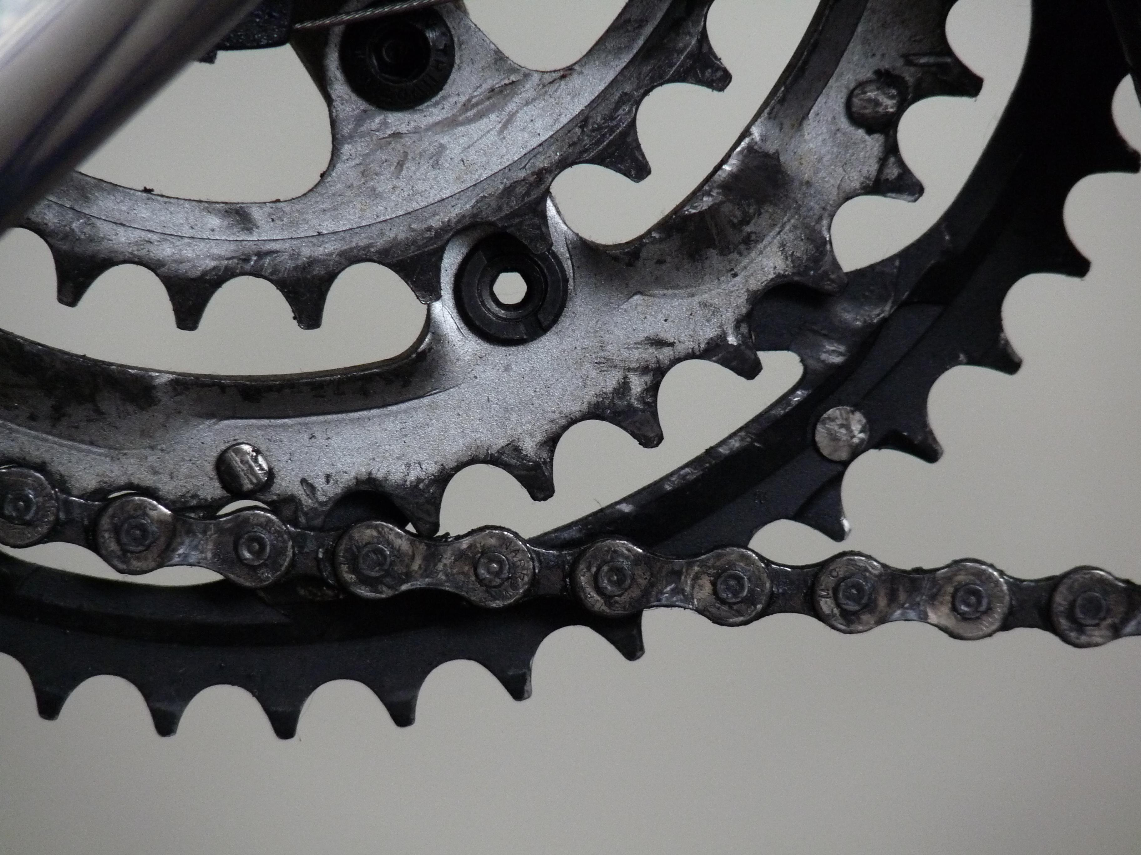
AZURE
AUTOMATION
習
Photo by bigal101/ morgueFile
Notes:
DEMO: Show Portal and running a simple job.
Image: Photo by bigal101/ morgueFile - http://mrg.bz/F7Ukmw

Slide 9
Azure
Automation
Multiple Authoring Types
Centralized Store
PowerShell
PowerShell Workflow
Graphical Runbooks
Shared values
Scheduling
Credentials
Modules
Highly Available
Execution History
Cloud execution
API for Management
Data stored for HA
Job history
Reportable

Slide 10




DEFINITIONS
///
$_
Assets
Azure Subscription
Azure Automation Account
Job1
Job2
Runbooks
Job3
Images: Office Clip Art & Azure Symbols by Microsoft

Slide 11

SECURITY
///
Image: “Untitled” by Ricardo Enriquez / MorgueFile
Notes:
You have the ability to create “Run As” accounts for both Classic (ASM) and ARM. Both create certificates that are then used to authenticate to your subscriptions to manage resources.
Image: “Untitled” by Ricardo Enriquez / MorgueFile

Slide 12
Hourly
Monthly
Once
Daily
Weekly
SCHEDULE
OPTIONS
習
Images: Office Clip Art
Notes:
How jobs run – Schedule
Daily, hourly, weekly, monthly or once
The scheduling options have improved greatly since the initial release! You can now choose what day of the month (including a blanked “Last day”), multiple days of the week, etc. You can also set the timezone for the schedules so that it operates when you expect it to and adheres to Daylight Savings if you wish.
Go show larger script and come back once it starts executing to describe what’s going on in the background.
Images: Office Clip Art

Slide 13



EXECUTING JOBS
///
Job Data History
Runbook
Job
Automation Workers
Images: Office Clip Art & Azure Symbols by Microsoft

Slide 14
HIGH AVAILABILITY
///
Runbook
Job
Automation Workers
Images: Office Clip Art & Azure Symbols by Microsoft

Slide 15

///
SUSPENSION & RESUMING
MANUAL
EXCEPTION
SCRIPT
LONG RUNNING
HA
習
Images: Office Clip Art

Slide 16

SCENARIOS
Images: Office Clip Art
Notes:
Image: Office Clipart

Slide 17

Run
Hybrid
Images: Office Clip Art
Notes:
Run on Azure Stack, but also using Hybrid Workers and Azure OMS.

Slide 18
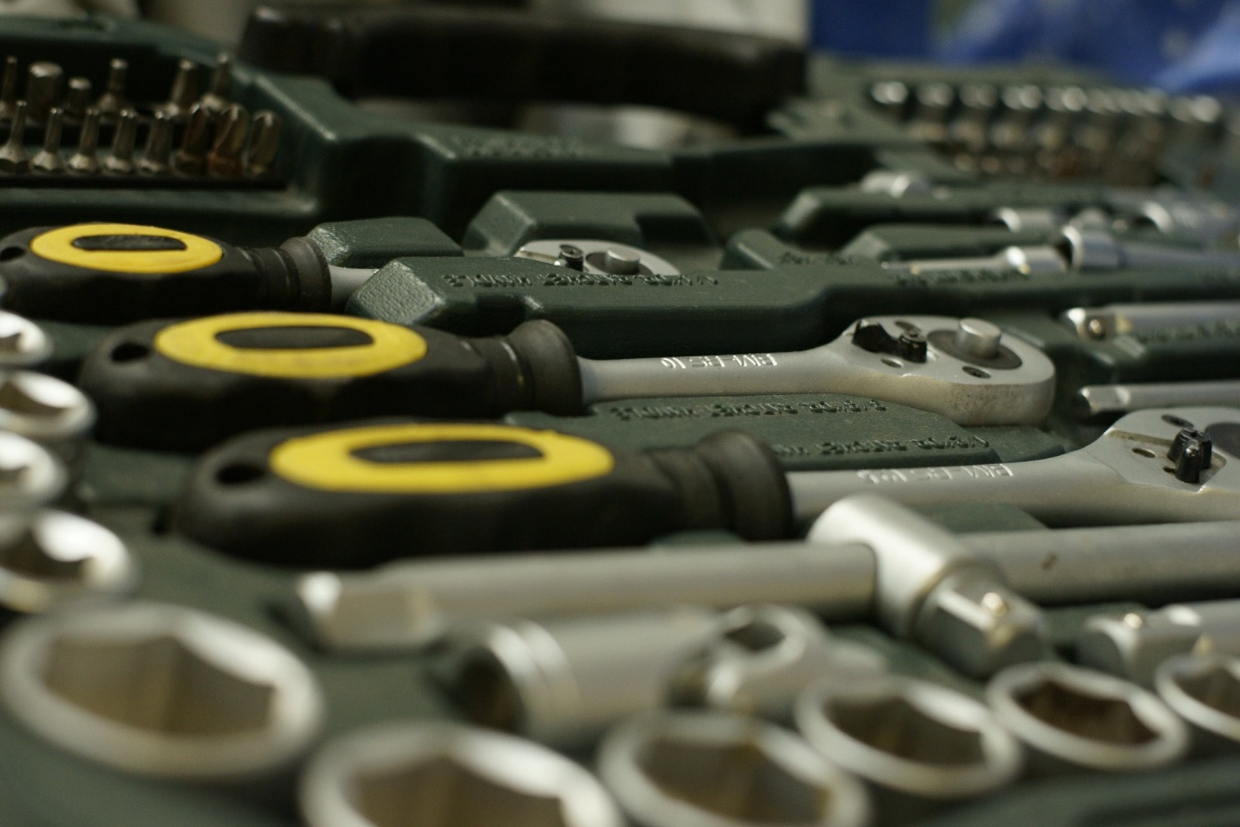
DATA
MAINT?
PATCHING
Photo by GaborfromHungary / morgueFile
Notes:
Running maint. Scripts for Azure SQL DB or other data services, data retention scenarios. Actually the Azure Elastic Jobs is MUCH better at this than Automation as you aren’t going to be paying for code that is just waiting for the SQL DB to complete processing.
Patching of VMs via Windows Updates
Photo by GaborfromHungary / morgueFile - http://mrg.bz/nfwlhc

Slide 19
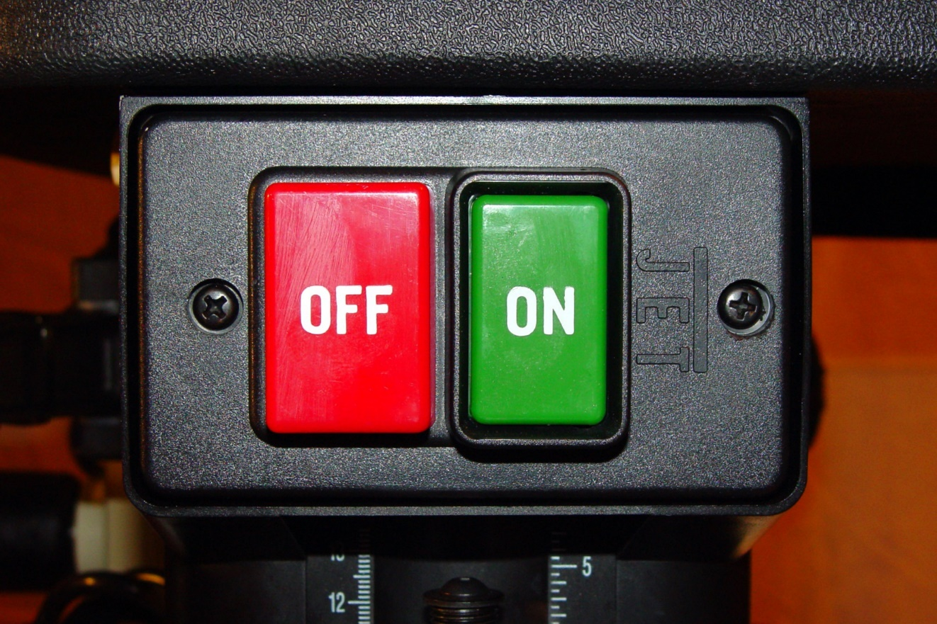
SCALE TO
ZERO
Photo by Click/ morgueFile
Notes:
Deployment swap over of assets? TTL traffic manager/DNS; on/off workloads
Photo by Click/ morgueFile - http://mrg.bz/qZtlDx

Slide 20
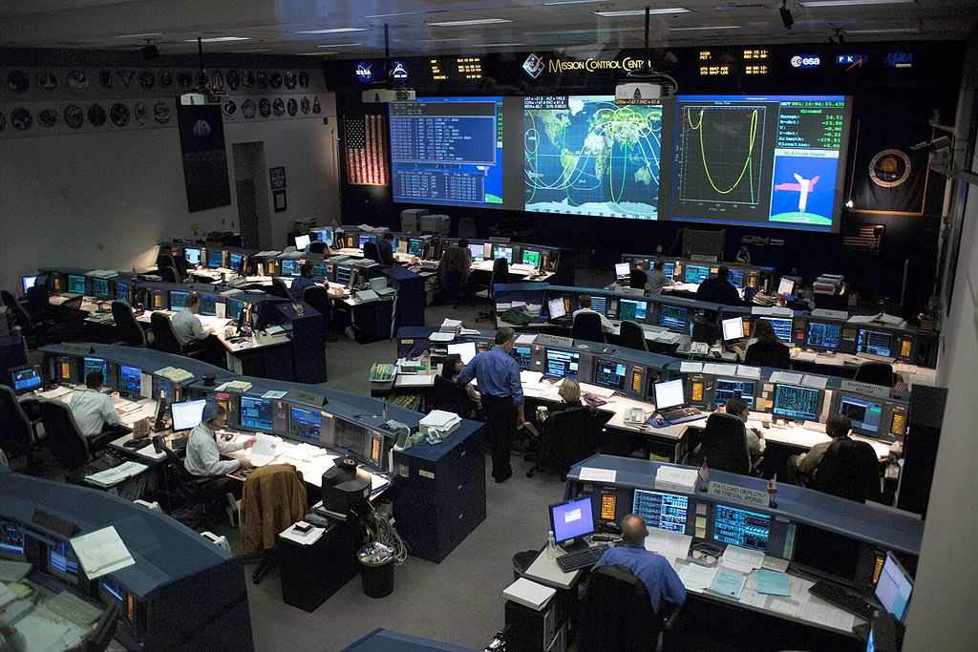
MONITOR
REACT
Azure Alerts & Webhooks
““Mission Control Center” by NASA / Public Domain
Notes:
React to events by polling in the runbook or calling the runbook externally. This is better to handle with calling the runbook externally to trigger it.
Photo: “Mission Control Center” by NASA – Public Domain - http://en.wikipedia.org/wiki/File:Mission_control_center.jpg

Slide 21
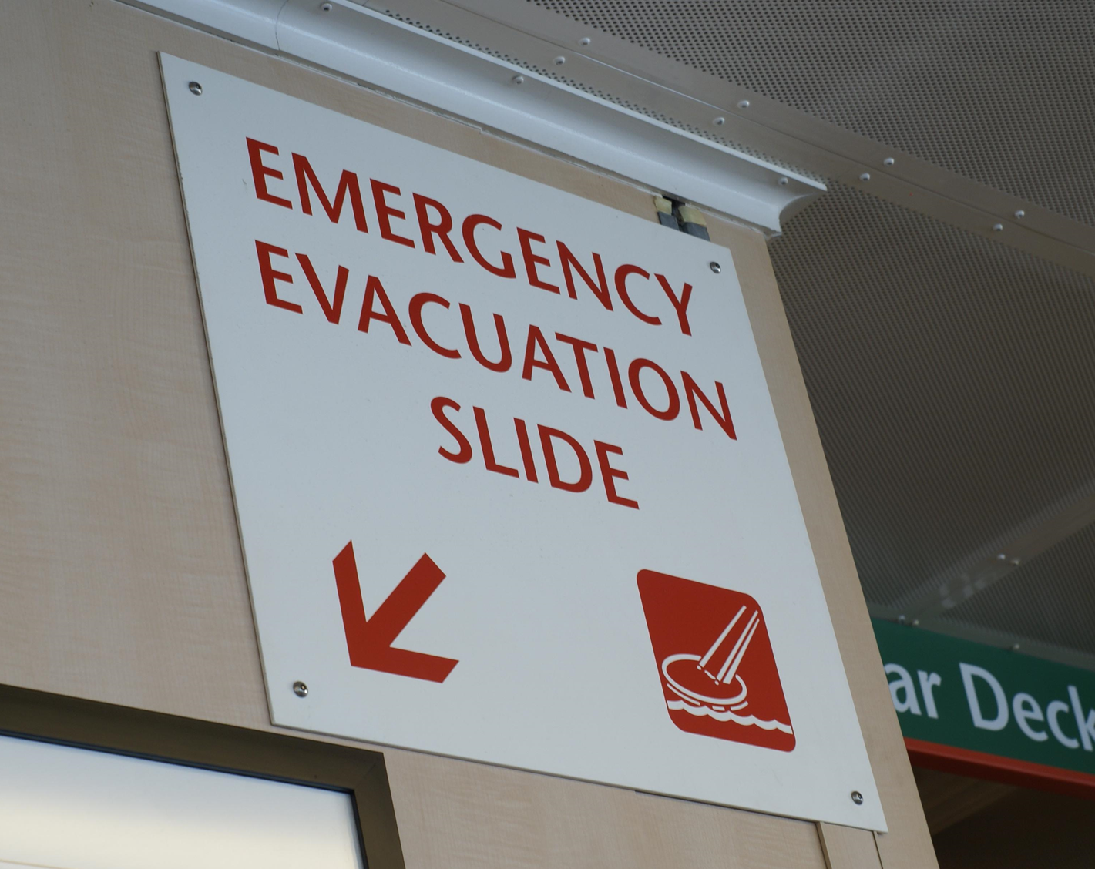
DISASTER
RECOVERY
“Ferry Signage” by Stuart Whitmore/ Morguefile
Notes:
You can leverage this automation platform to handle disaster recovery events. Maybe you have a cut over script you use to update your system to point to a fall back region, or you have a set of scripts that deploy your solution to a secondary region in a cold backup scenario.
Photo: “Ferry Signage” by Stuart Whitemore – Morguefile- http://mrg.bz/c33174

Slide 22
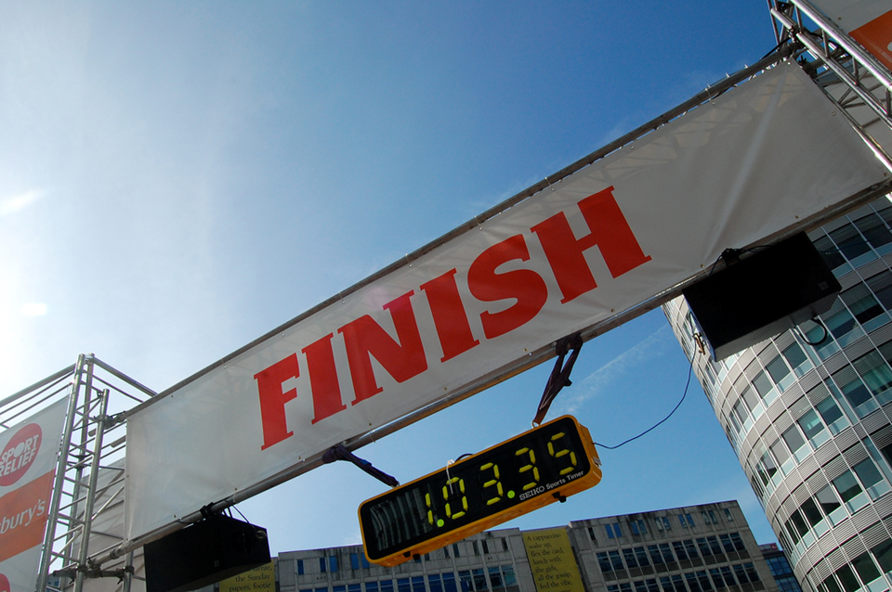
WRAPPING UP
“Finish Line” by jayneandd / CC By
Notes:
Image: “Finish Line” by jayneandd / CC By - https://www.flickr.com/photos/jayneandd/4450623309/sizes/l/

Slide 23
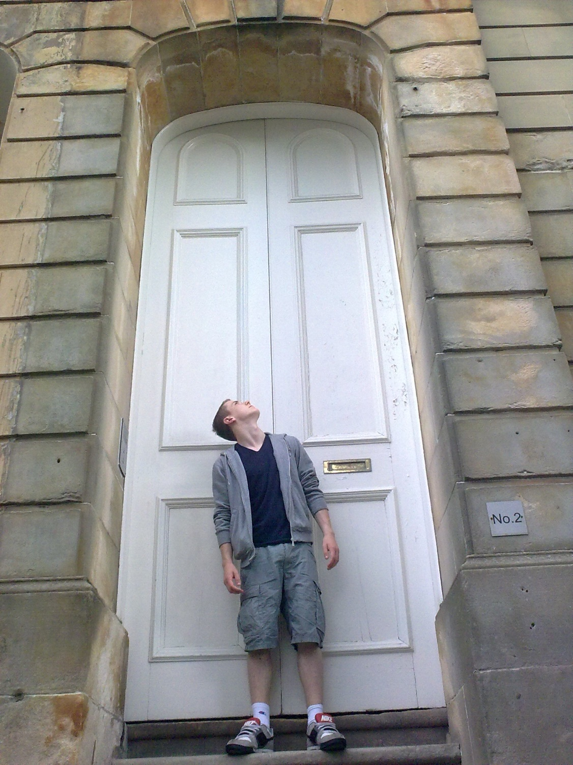
Automate!!
Humans Don’t Scale Well
Consistency Matters
Be Prepared
Photo by mantasmagorical/ morgueFile
Notes:
Photo by mantasmagorical - MorgueFile - http://mrg.bz/4cuBQE

Slide 24
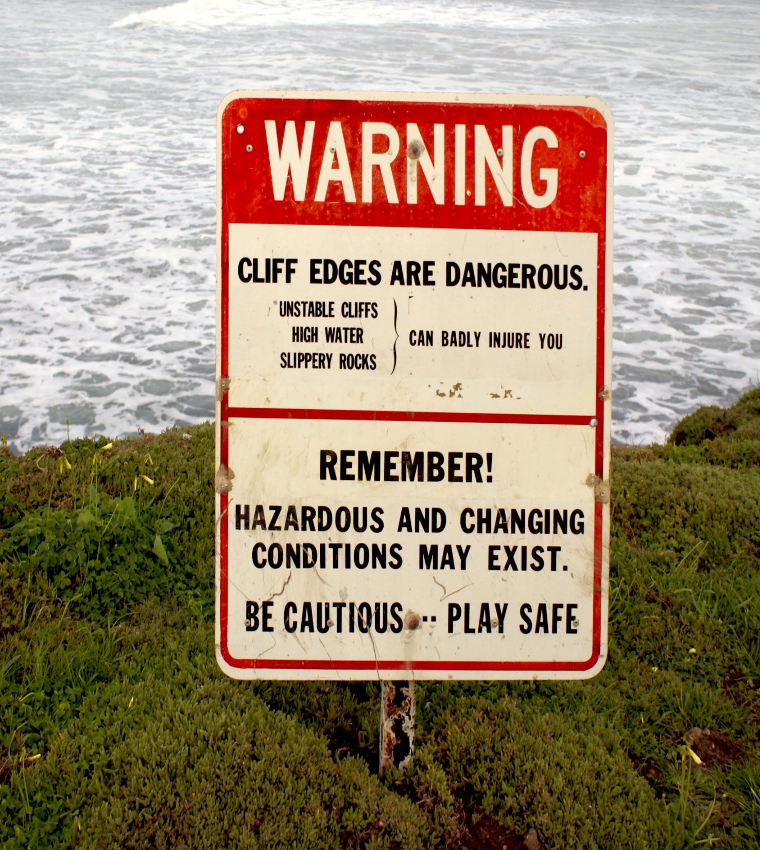
BE CAUTIOUS
//////////////////////
Photo by taliesin/ morgueFile
Notes:
Image: Photo by deegolden / morgueFile - http://mrg.bz/zAf49s

Slide 25
Thank You
Mike Wood
mwood@sentryone.com
mvwood.com @mikewo

